Slide 1
Sitting Duck
Cellular Phone Detection for Information Sensitive Settings
October 14th, 2016
Preliminary Design Review

Slide 2
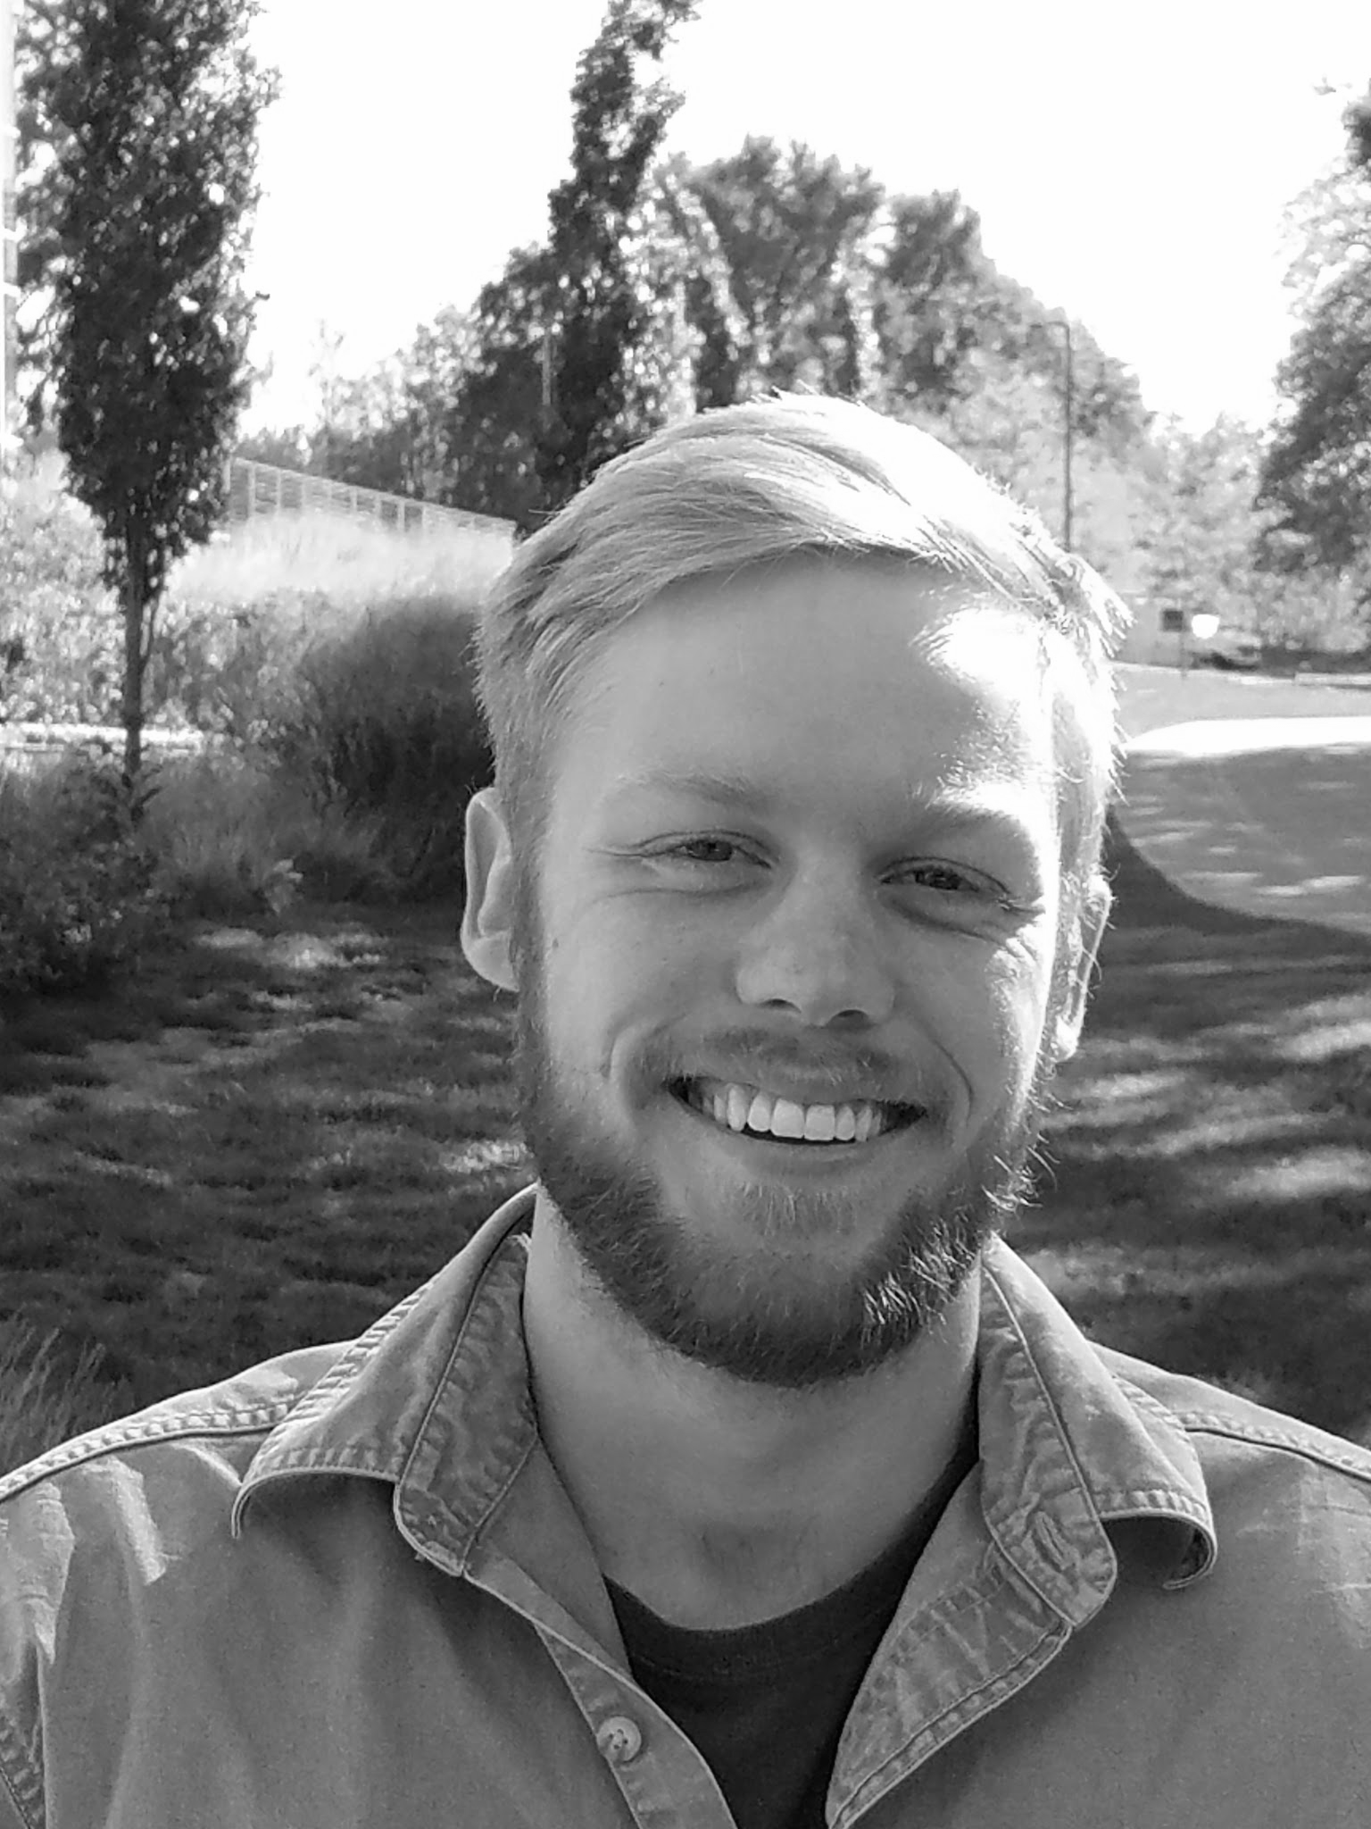
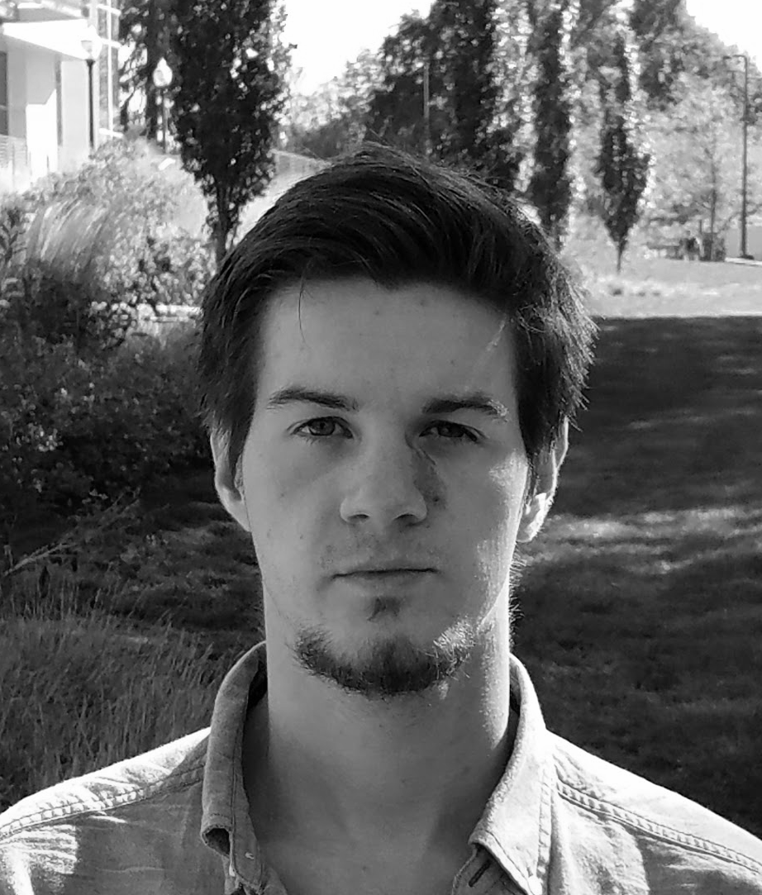
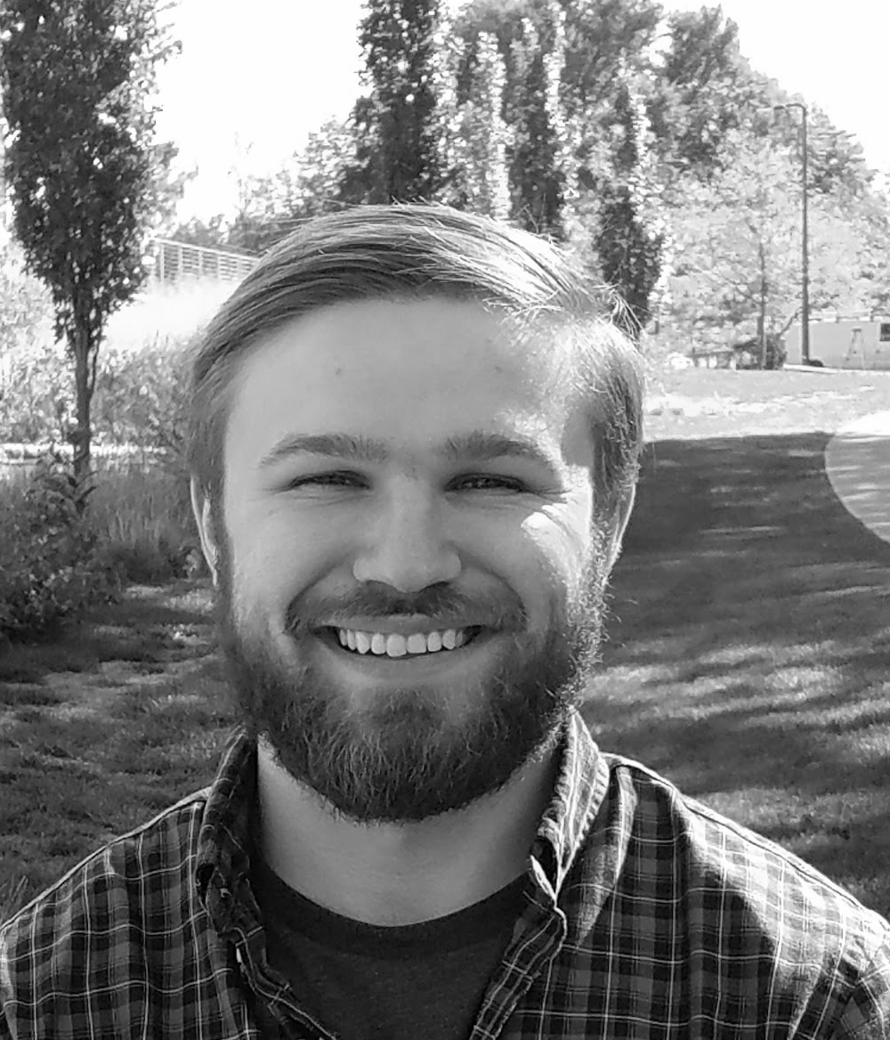
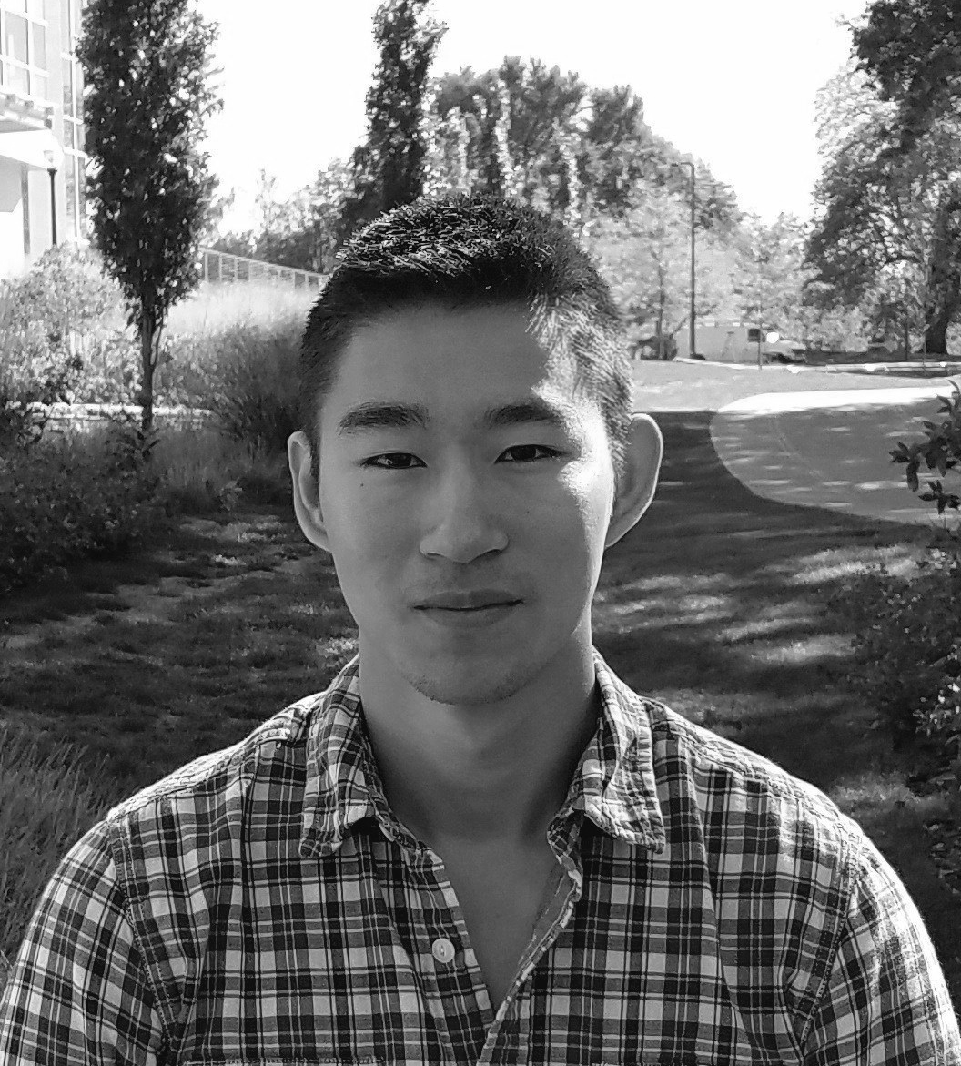
The Team
Sean Turner
EE
Michael Sheehan
EE
Jonathan Jamroga
CSE
Jonathan Yam
CSE

Slide 3
What is the Problem?
There are countless situations in which cellular phone use is strictly prohibited.
This occurs principally in places where information is not meant to come in or out, and for good reason.

Slide 4
Who Cares?
Testing Centers
Standardized testing is the most prevalent method of evaluating aptitude (e.g. SAT, GRE, MCAT) and ability (e.g. Bar Exam, Medical Board Exams).
Government
Homeland Security is very information sensitive.
Corporate
Trade secrets and strategies often rely on confidentiality.

Slide 5
Current Solutions
No Device Policy:
- Adherence relies on honesty or invasive measures.
Live Observers:
- Subject to human error.
- Only effective with significant manpower.
Handheld RF Detector:
- Are not capable of localizing transmissions without manual effort and are ineffective against momentary transmissions.
Shielding and Active Jamming:
- Active mitigation. Blocks potentially authorized transmissions.

Slide 6
Goal Description
Develop a single-room detection system that identifies where and when cell phone use occurs and allow the user to easily visualize and review detection events.
- Non-invasive
- Eliminates manpower and human error
- Selective video evidence
- Ease of use

Slide 7
System Requirements
Accurate
- Localize detection at 40’ range to within ±5° (≅6’ arclength)
- <30 second sensor to GUI presentation latency
Easy to Use Presentation
- Real video feed with 2D heat map overlay
- User can playback stored events from times of detections
Operates on commercial cellular phone frequencies
- 850MHz for proof concept
- Custom Designed, Fabricated RF Bandpass Filter

Slide 8
System Overview

Slide 9
Block Diagram

Slide 10
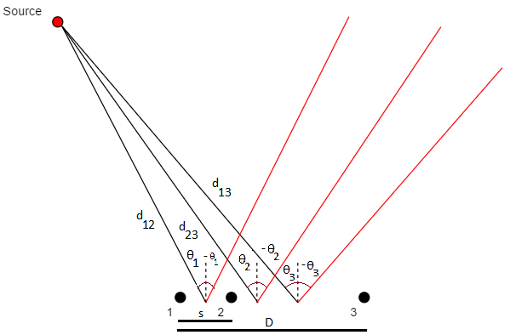
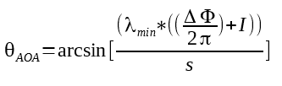


Calculating Angle of Arrival

Slide 11
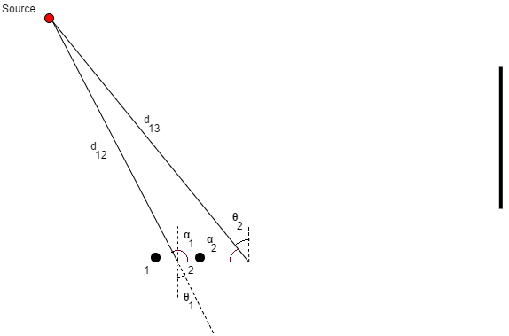




Signal Source Triangulation
s

Slide 12
Processing Algorithm
Parameters: 2D Room Dimensions, Desired FOV θ
Loop:
Receive Δɸ₁, Δɸ₂, Δɸ₃
Calculate the 6 ambiguous Angles of Arrival
Calculate azimuth convergence
Detect and handle overlapping transmissions
Store Location and Time
Control:
Interfacing with GUI, camera interface, storage

Slide 13
Expected Cost
Item | # Units Req. | Unit Cost | Total Item Cost
RF Filter Fabrication | 3 | $50 | $150
AD8302 Gain/Phase Detector | 3 | $20 | $60
3G Antenna | 3 | $25 | $75
A/D Converter | 1 | $60 | $60
USB Camera | 1 | $20 | $20
Coaxial Cable and Power Dividers | N/A | N/A | $45
Total Cost |  |  | $410

Slide 14
MDR Deliverables
RF Bandpass Filter
Paper design and simulation complete
Power Source
Paper design and simulation complete
Algorithm Development
Developed Angle of Arrival and Compute Position algorithms in MATLAB. Tested with simulated sensor inputs.
Developed data structure for outputs and history.
Camera and GUI
Camera interfacing and encoding methods analyzed and tested

Slide 15
Responsibilities - Sean Turner

Slide 16
Responsibilities - Michael Sheehan

Slide 17
Responsibilities - Jonathan Yam

Slide 18
Responsibilities - Jonathan Jamroga

